Slide 1

ONLINE COMPILER USING CLOUD COMPUTING
Computer Science Project I – CS691
Anchal Singh
Ramesh Kyasaram
Tushar Rakholiya
Sanath Gholap
Harshada Chaudhari

Slide 2

INTRODUCTION
In today’s fast and competitive world everything is available on internet, and on web. So, we developed an online compiler using cloud computing. The main objective of this project is to develop a centralized compiler that helps to reduce problems like portability storage, cost, and space.
It is the most convenient tool to compile code, remove errors and debug code. Moreover, we can run the web-based application remotely from any network connection that is independent of platform. The challenge of installing a compiler on each machine is also avoided and therefore, these all benefits make this application suitable of cloud based online compiler make it suitable for performing online exams.

Slide 3

PERSONA
I am John pursuing Master’s from a well-known university. Being a Graduate student in Computer Science, writing and compiling codes in different languages is part of our daily life. Sometimes we find it difficult to get the subscription for different compiler because it’s costly and it will become more costly if we are taking subscription for different compiler for each coding languages.
Therefore, we yearn for a single platform where we can compile at least more frequently used languages (Java, Python, C#, C, C++) at the same platform by making the coder’s life easier.

Slide 4

TECHNOLOGIES USED
Google Cloud Platform
Python(Flask) (Middleware Business Logic)
HTML/CSS (Front-end)
MongoDB (Database)

Slide 5
Sprint 2 Recap
Issue Type | ID | Summary | Priority | Status | Expected Hours | Total Hours (Completed)
Task | ONCC-3 | Discuss and Research Database Design | High | Done | 3 | 3
Task | ONCC-8 | Initialize Web Application | High | Done | 7 | 7
Task | ONCC-10 | Research about the compiler module | High | Done | 8 | 8
Task | ONCC-7 | Finalizing Database | Medium | Done | 6 | 6
Task | ONCC-9 | Research about the Cloud Service to be used. | Medium | Done | 3 | 3
Task | ONCC-6 | Learning Python Flask | Medium | Done | 8 | 8

Slide 6

SPRINTS
Sprint 1
Sprint 2
Sprint 3
Facilitate Compiler with Java module
Develop Login Module with flask(Python)

Slide 7
Sprint 3 Artifacts
Issue Type | ID | Summary | Priority | Status | Expected Hours | Total Hours (Completed Hours)
Task | ONCC-11 | Initiate the compiler module with python | High | Done | 15 | 15
Task | ONCC-12 | Database Design | High | Done | 6 | 6
Task | ONCC-13 | Create database table for user and registration | High | Done | 5 | 5
Task | ONCC-14 | Design login page | Medium | Done | 4 | 4
Task | ONCC-15 | Design Registration page | Medium | Done | 4 | 4
Task | ONCC-16 | Connection between web application and database | Medium | Done | 6 | 6
Task | ONCC-17 | Initiate the REST API development-GET command | Medium | Done | 5 | 5
Sprint 3 Goal:
Design login and Registration Page
Create User Table in MongoDB
Connect web application with MongoDB

Slide 8
Sprint 3 Test Cases
Test Cases for | ID | Steps | Test Scenario | Test Data | Expected Results | Actual Results | Pass/Fail
Registration | ONCC-15 | 1 | Check registration form with First name | Sanath | NO Validation Errors | NO Validation Errors | PASS
 |  | 2 | Check registration form without first name | *Blank* | Validation Errors | Validation Errors | PASS
 |  | 3 | Check registration form with Last name | Gholap | NO Validation Errors | NO Validation Errors | PASS
 |  | 4 | Check registration form without Last name | *Blank* | Validation Errors | Validation Errors | PASS
 |  | 5 | Check registration form with vaild email | sanath2097@gmail.com | NO Validation Errors | NO Validation Errors | PASS
 |  | 6 | Check registration form without email | *Blank* | Validation Errors | Validation Errors | PASS
 |  | 7 | Check registration form with Password | testpassword | NO Validation Errors | NO Validation Errors | PASS
 |  | 8 | Check registration form without Password | *Blank* | Validation Errors | Validation Errors | PASS
 |  | 9 | Check registration form with invalid email | sanathgholap.com | Validation Errors | Validation Errors | PASS
 |  | 10 | Check registration form with confirming Password | *Wrong password in confirm field* | NO Validation Errors | NO Validation Errors | PASS
Compiler | ONCC-11 | 1 | Choosing the language from the drop-down menu with selecting a language | Java/Python/C/C++/C# | NO Validation Errors | NO Validation Errors | PASS
 |  | 2 | Choosing the language from the drop-down menu without selecting a language | *Blank* | Validation Errors | Validation Errors | PASS

Slide 9
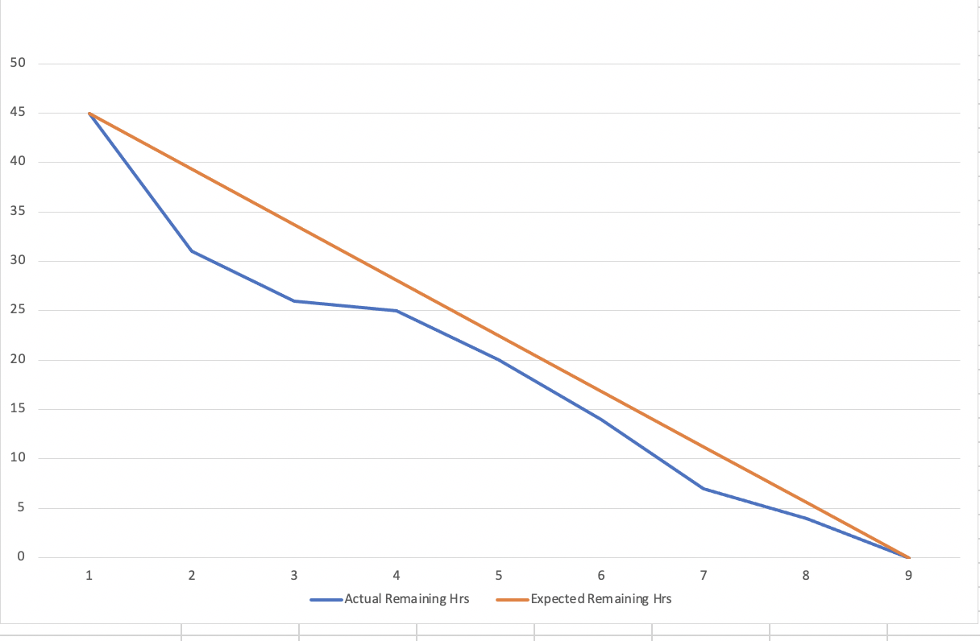
Sprint 3 Hours Burndown
October 6, 2020 - October15, 2020
We used Excel sheet to express our burndown charts.
This chart is based on Total Hours
Expected Hours=45
Completed Hours=45
Completed Artifacts (hours) = 100%

Slide 10
Product Backlog
Issue Type | ID | Summary | Priority | Status | Story Points
Story | ONCC-19 | As a Guest User, I want to have an option to select Java programming language so that I can compile my code written in Java language | High | Done | 8
Story | ONCC-20e | As a Registered User, I want to have a login page so that I can use features like save and edit existing code which are exclusively available for registered users only | High | Done | 2
Task | ONCC-21e | Decoding the password while comparing the password | High | Done | N/A
Task | ONCC-22e | Initiate the saving source code module in front-end | High | Done | N/A
Task | ONCC-23e | Create table for saving source code | High | Done | N/A
Task | ONCC-24e | Aggregation of the tables for saving source code to specific user | High | Done | N/A
Task | ONCC-26e | Create session for each user after login | High | Done | N/A
Task | ONCC-18e | Existing user can not re-register | Medium | Done | N/A
Task | ONCC-25e | REST-API Put, Update, Delete Command | Medium | Done | N/A

Slide 11
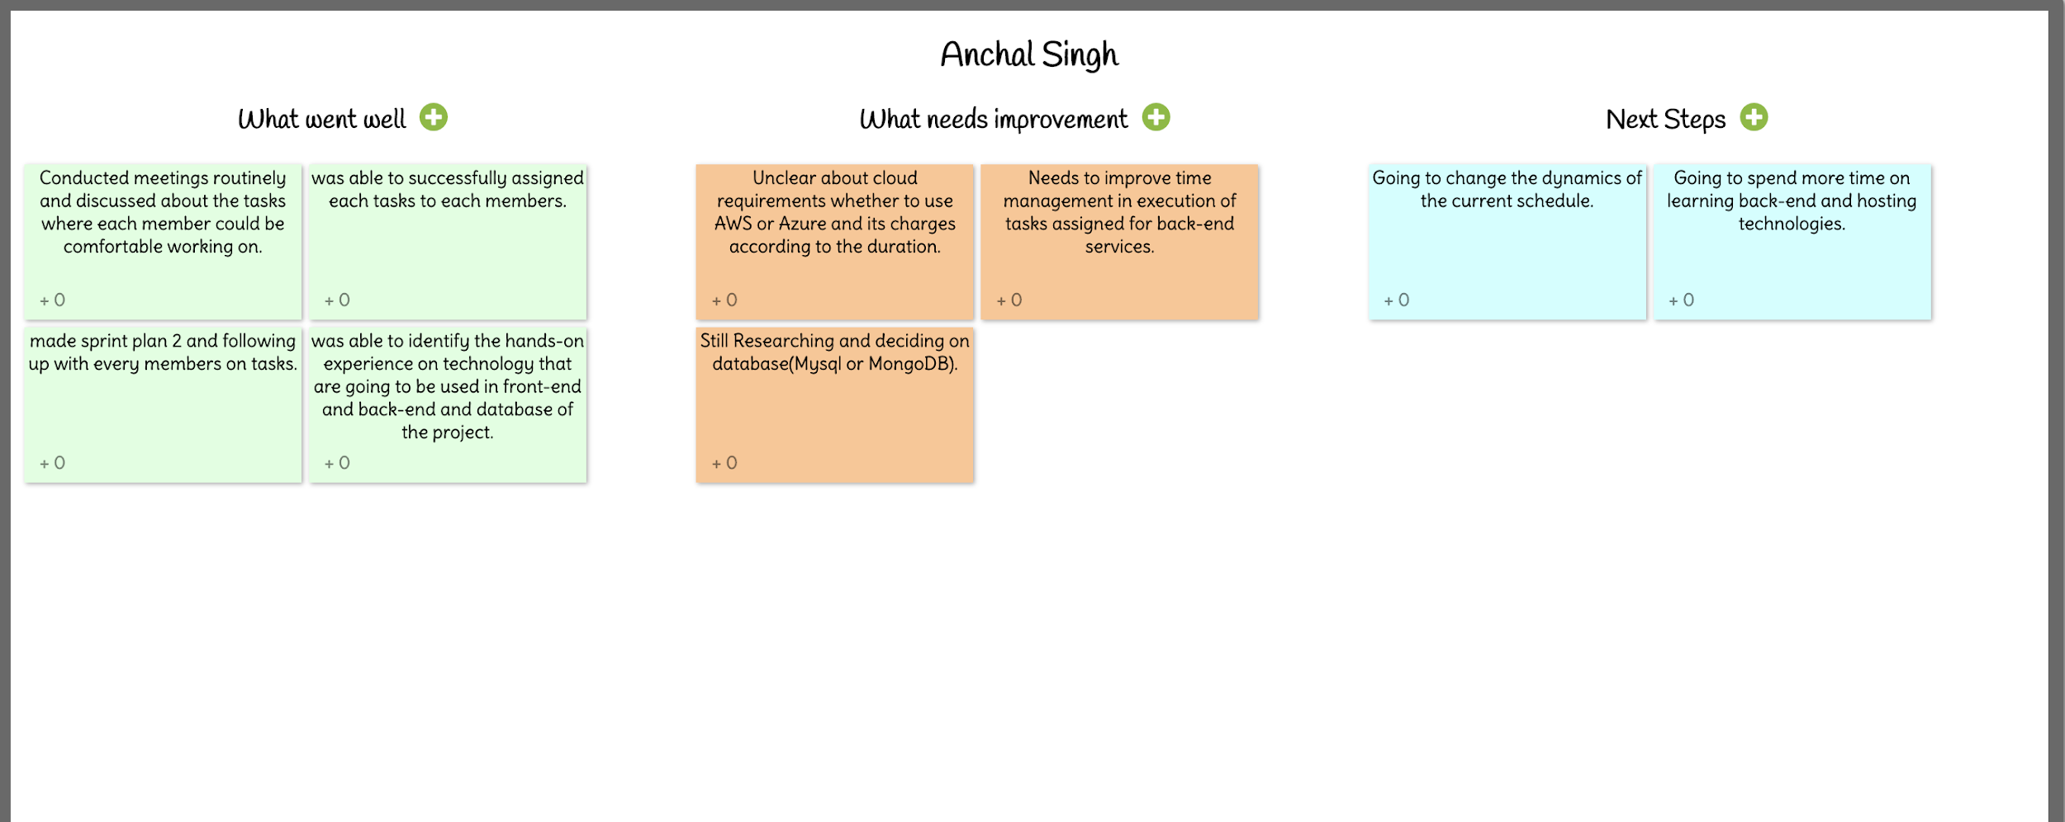
RETROSPECTIVE SPRINT 3

Slide 12
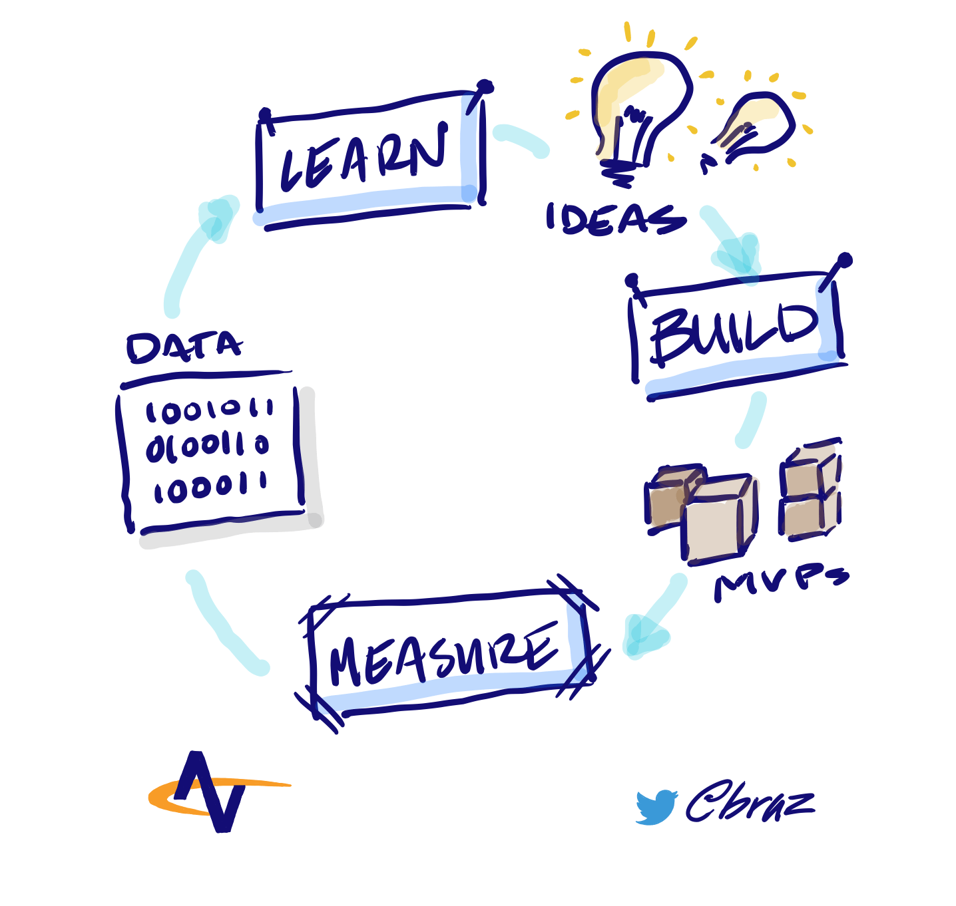
MVP
Which Problem does it solve!
It can be hectic for students or working professionals to download IDEs and virtual machines for individual languages to run their programs in very short amount of time.
Minimum :- An application which can just compile the code.
Viable : An online platform for everyone where anyone can run the code in any of the given programming languages with features like save the source code.
Minimum + Viable :- We are presenting a product which is based on cloud computing with features like login, registration with authentication and compilation of source code.

Slide 13

GITHUB LINK
https://github.com/sg99356n/OnlineCC/wiki/Online-Compiler-Using-Cloud-Computing

Slide 14
THANK YOU

